Slide 1
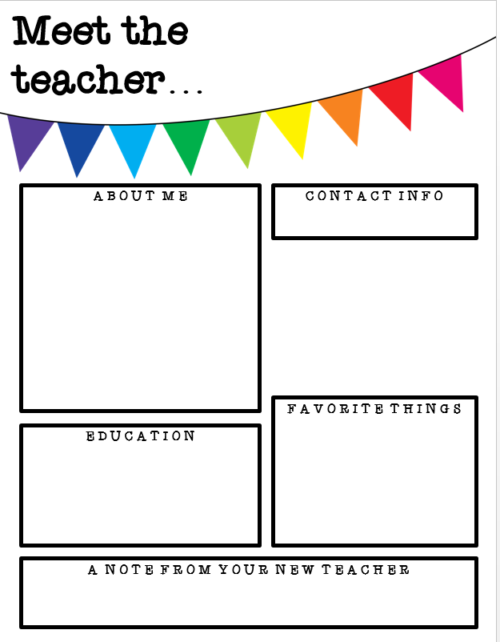
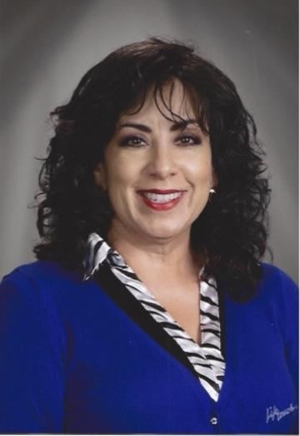
Mrs. Hoffecker
I was born and raised in Stockton. When I was in the third grade, I decided I wanted to become a teacher. I would play school at home with my stuffed animals and pets. (They got to be pretty smart! Lol) Eventually, I realized my goal of becoming a teacher. I have been named “Who’s Who Among America’s Teachers” several times. I have mentored many students to become teachers and mentored new teachers. I am even the ClassDojo Mentor for Cleveland School! I have been teaching for over 30 years and LOVE my job!
khoffecker@stocktonusd.net or message me on ClassDojo
Website: https://sites.google.com/stocktonusd.org/mrshoffeckersthirdgrade/home
Teaching! (of course)
Dachshunds (Weenie dogs)
Tigers
Reading books
Traveling the world
Cycling
Driving (cars not golf clubs)
Being with friends
Making people smile and laugh
Learning new things
I graduated from the University of the Pacific. (That is our classroom college.)
I hold a Bachelor’s of Arts, in Liberal Studies, A California Teaching Credential, A Language Development Specialists Credential and a Master’s Degree in Curriculum and Instruction.
I can’t wait to meet you. I know we will do GRReat things this year!
My class motto is “The PAWsibilities are endless when you believe in yourself!”

